Slide 1
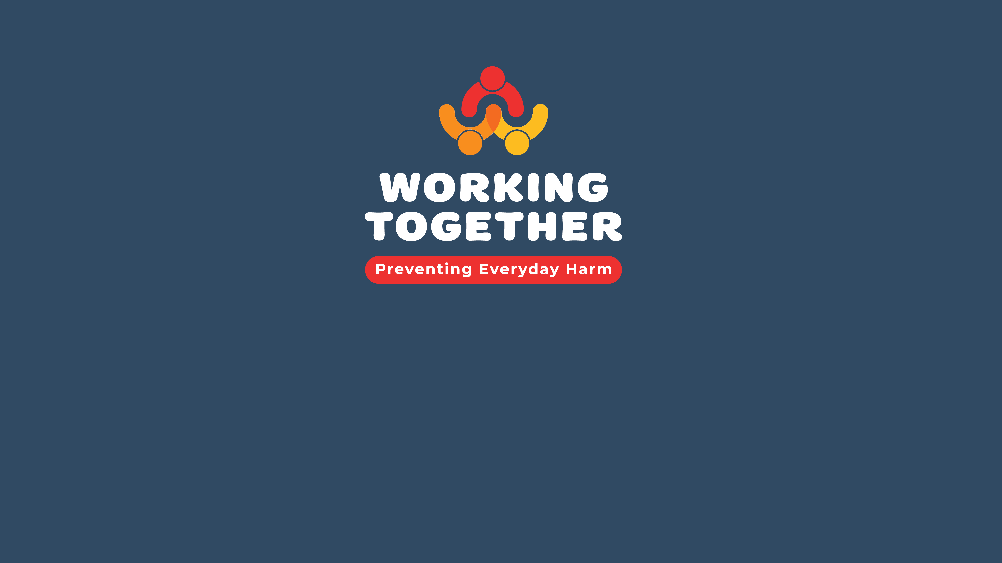
Workshop
Notes:
ADD LINK TO WEBSITE WHERE TRAINING IS LOCATED ON FRONT PAGE NOTES

Slide 2
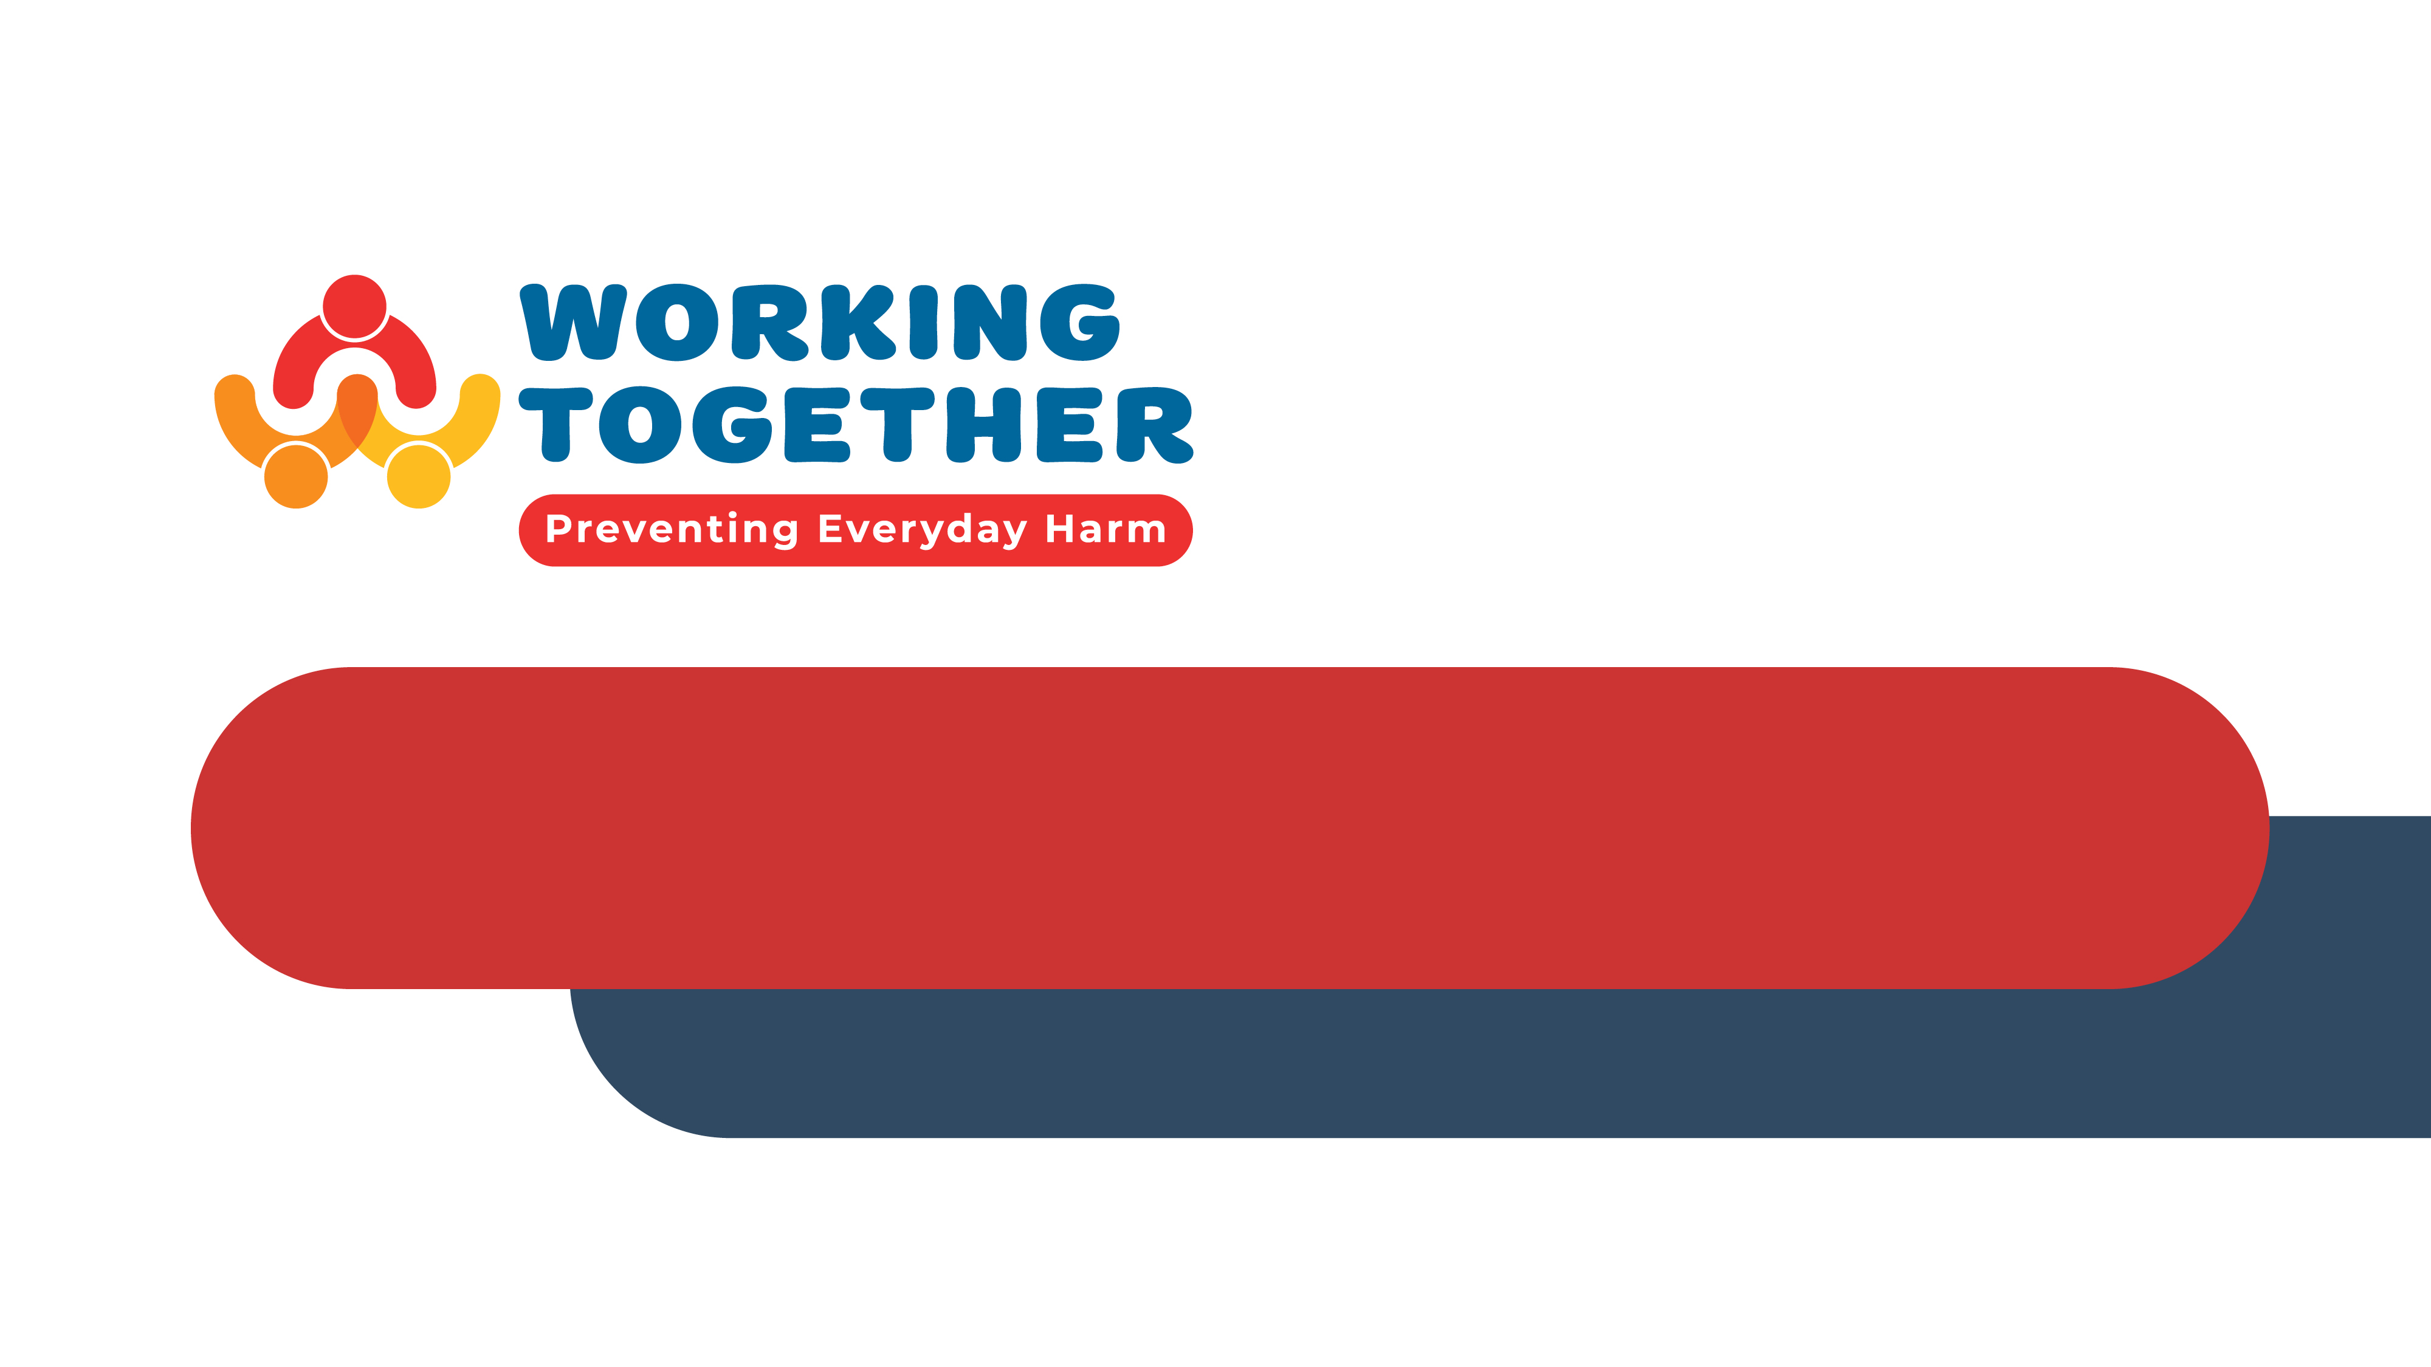
Acknowledgement of Country
Notes:
I would like to acknowledge the traditional owners of the land on which we meet to day and pay my respects to their Elders – past, present and emerging. I acknowledge that sovereignty has never been ceded – it always was and always will be, Aboriginal land.

Slide 3

Workshop overview
Understand everyday harm and why it matters
Learn how to prevent and address everyday harm
Improve how we work together to understand, prevent and address everyday harm in systems

Slide 4

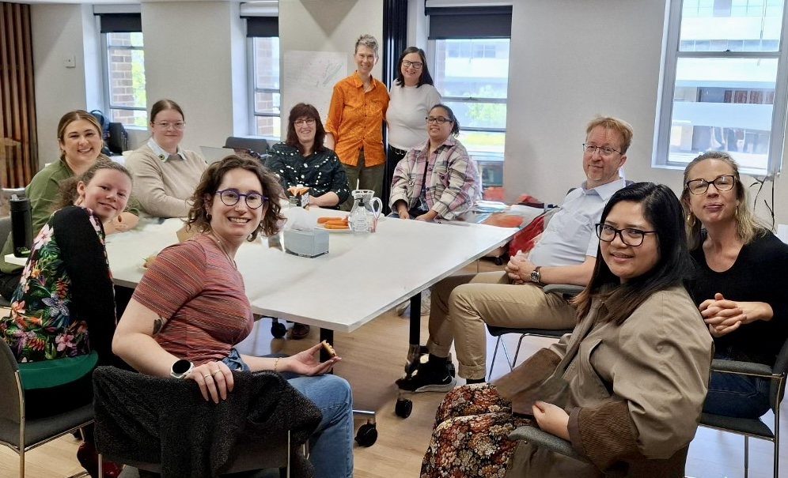

The Research Team
Notes:
Need talking points here

Slide 5
What makes a good
support relationship?
Working in pairs, discuss your response to the question below:
What you think makes a good support relationship?

Slide 6
What makes a good support relationship?
Good support means different things to different people
You know it is okay to disagree sometimes, as long as you try and work it out
You listen to each other
You pay attention to each other’s choices
You respect
each other
You take the time to learn new things together and practice
You do not boss each other around
You treat each other like part of the team
You arrive on time when you are working together
You celebrate when one of you does well or improves at something
You comfort each other when one of you is having a bad day

Slide 7
What is everyday harm?
Everyday harm is the negative impact on a person when someone does or does not do something (actions and inactions).
The harm can be to the person’s
Feelings
Mental health
Physical health
Relationships
Reputation
Growth and learning

Slide 8
Why does everyday harm matter?
Occurs frequently in everyday interactions
Often overlooked or brushed off
Can build over time
Is hard for people to express what has happened to them
Less likely to be addressed clearly in policy
People, workers and organisations need to know what it is so they can notice it, support people when they experience it and change practices to prevent it.

Slide 9
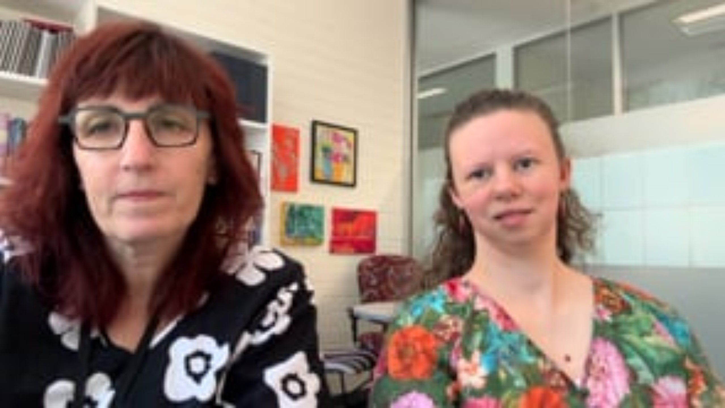
Consider
The films we use show people with a disability feeling hurt, left out or not respected.
This might make people feel sad, upset, angry or worried.
You can stop at any time
You can take a break
You can choose to watch the films later

Slide 10
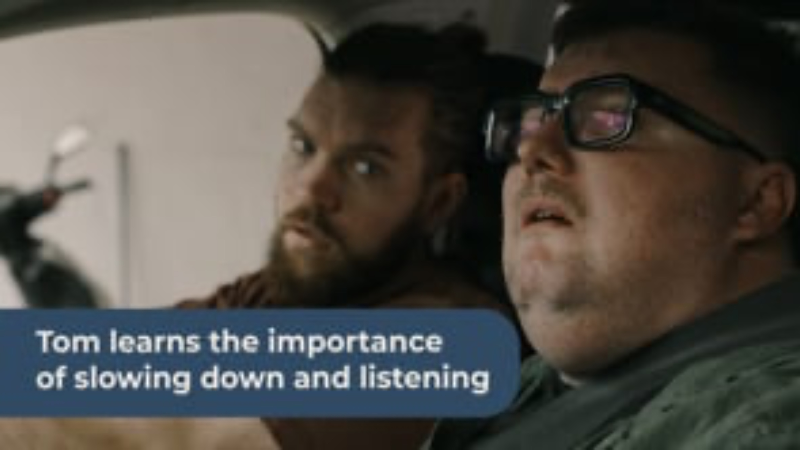
Zac’s Story

Slide 11
Reflect on Zac’s story
In small groups consider Zac’s story and respond to the questions below:
How did the everyday harm come about? (Notice)
How did Tom, the support worker, notice things were not ok? (Notice)
What did Tom do once he noticed everyday harm was happening? (Acknowledge)
What did Zac and Tom do to respond / take action together? (Respond)
What did Tom do to make his support relationship with Zac better? (Repair)
How could Zac and Tom stop this from happening in the future? (make things better)

Slide 12
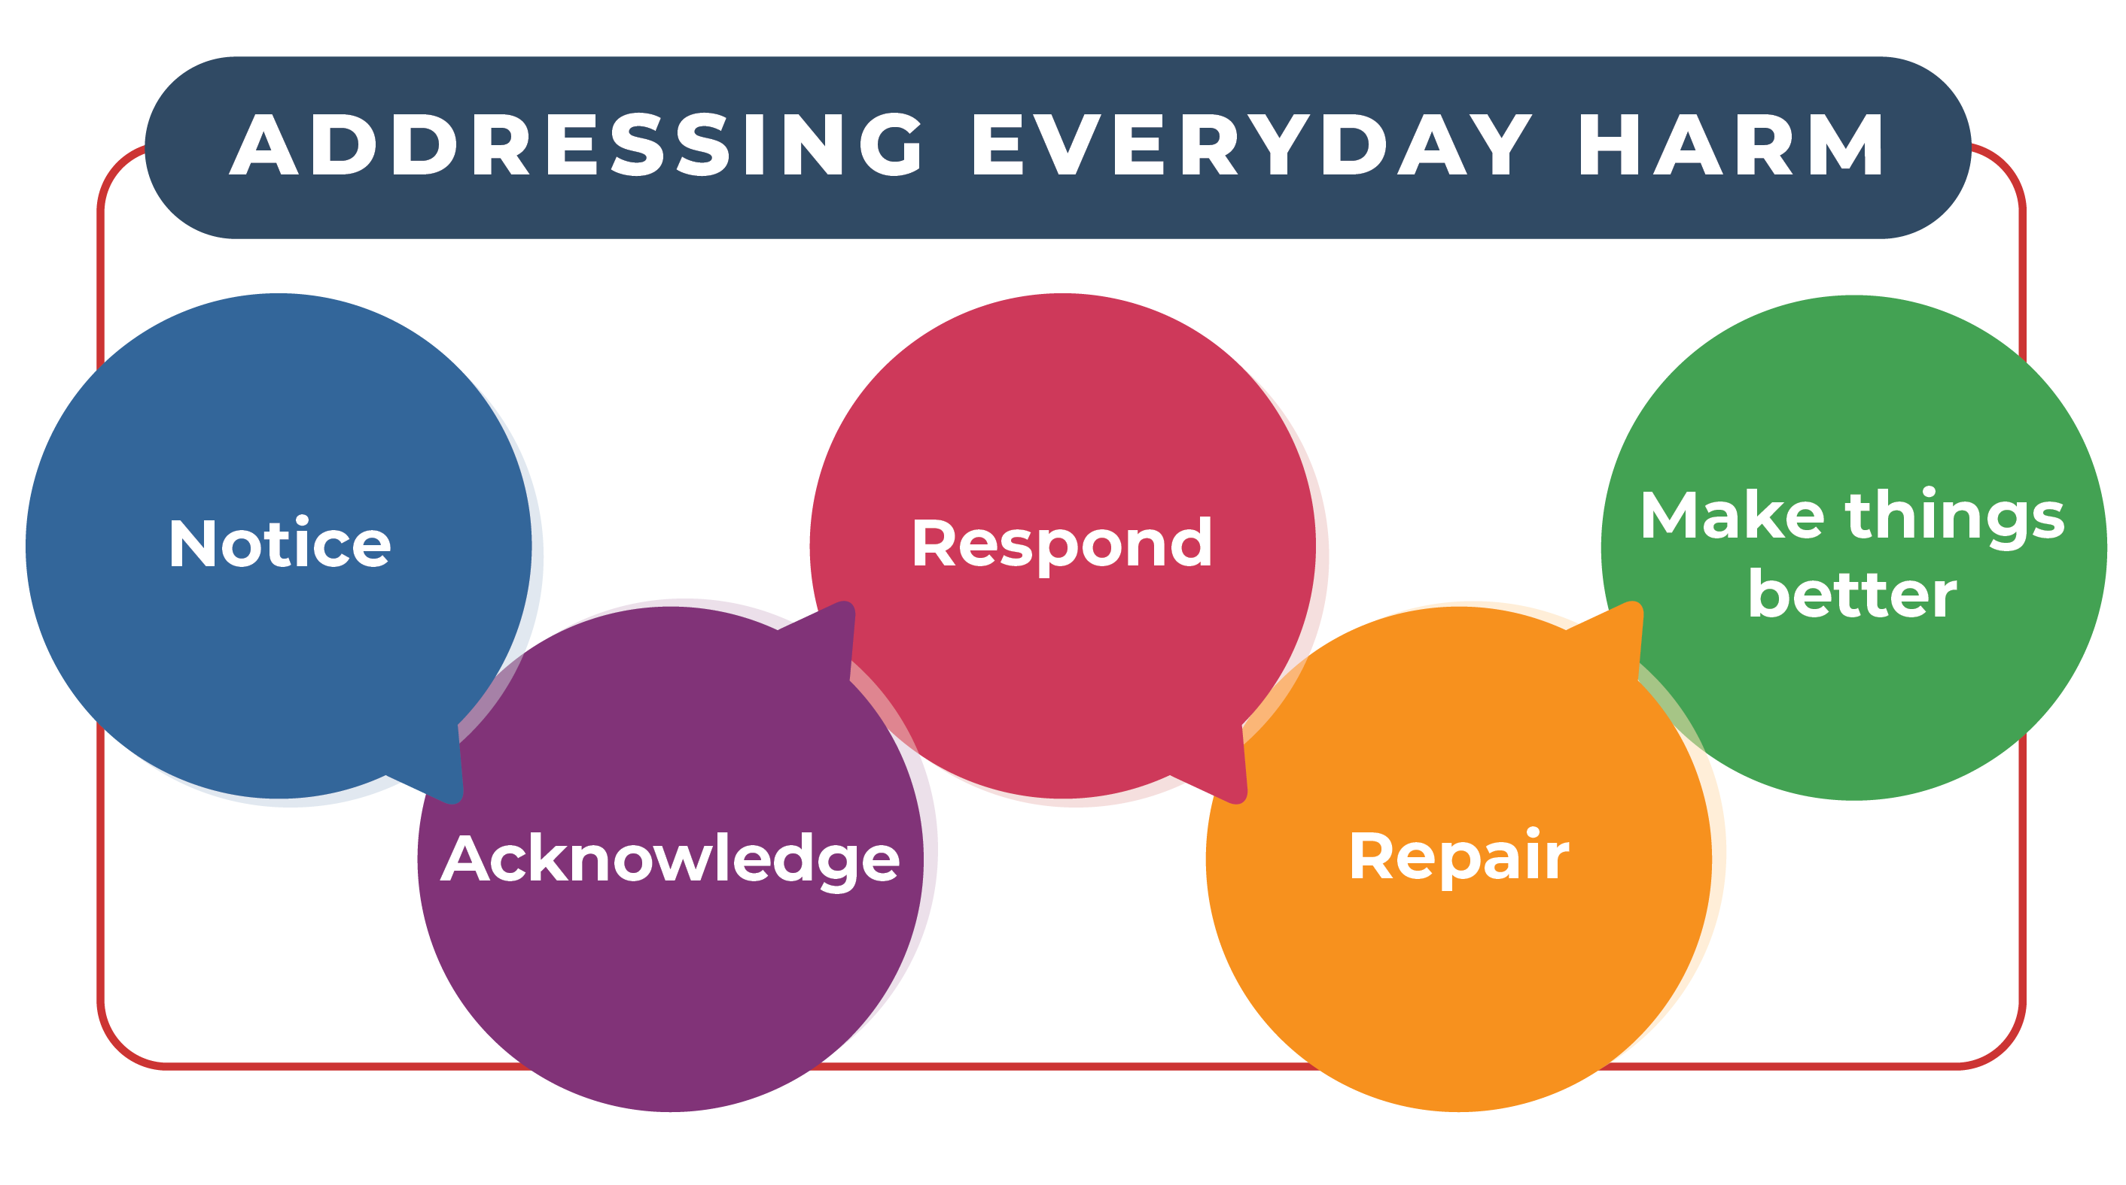
Everyday steps to address and repair everyday harm

Slide 13
Notice the everyday harm
Noticing everyday harm helps us address it.
We can
Learn to name everyday harm to help us notice it
Practice naming and describing everyday harm
Take time to develop trust with people
Learn about each other’s communication preferences
Learn about past experiences of harm

Slide 14
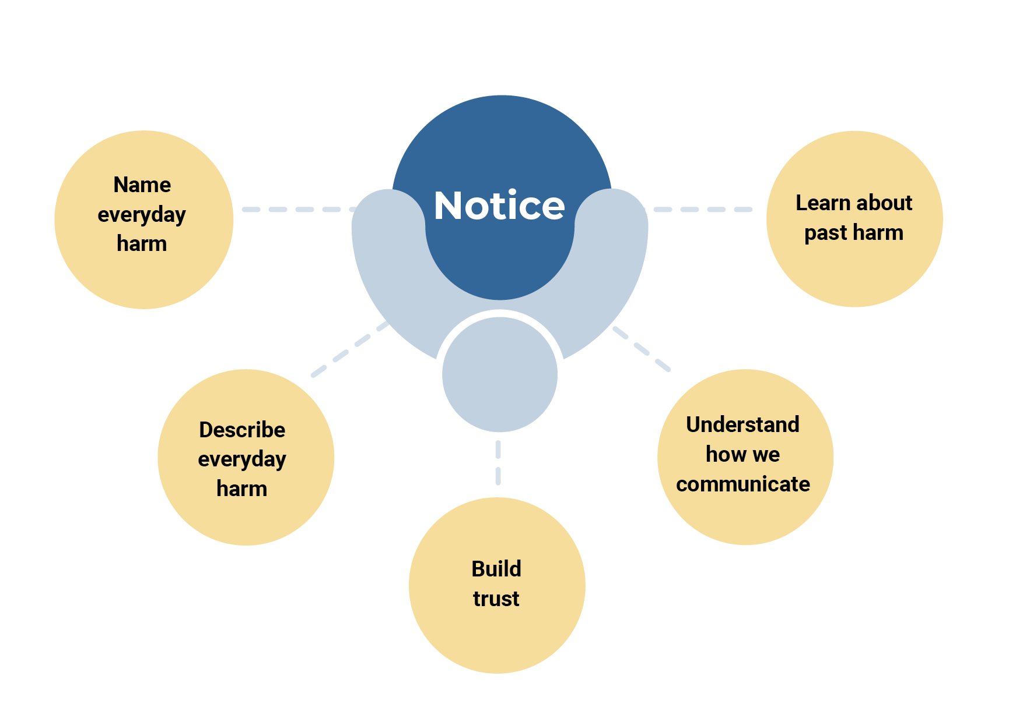
Notice the everyday harm
Notes:
Notice when a place does not have a good vibe.

Slide 15
Acknowledge everyday harm
When we think everyday harm has happened, we can check in with each other about it.
We can
Ask if harm has happened
Name and describe the harm
Communicate about the harm experienced
Describe what caused the harm
Notes:
When we think everyday harm has happened, sometimes we are not sure. There are lots of ways to check in with each other about it. We can ask if harm has happened. We can name and describe the harm. We can communicate about harm we experienced. We can describe what caused the harm.
We can make time to give feedback about the support we receive. We can ask for feedback about the support we give. We can make time for safe and easy ways to share experiences of harm.

Slide 16
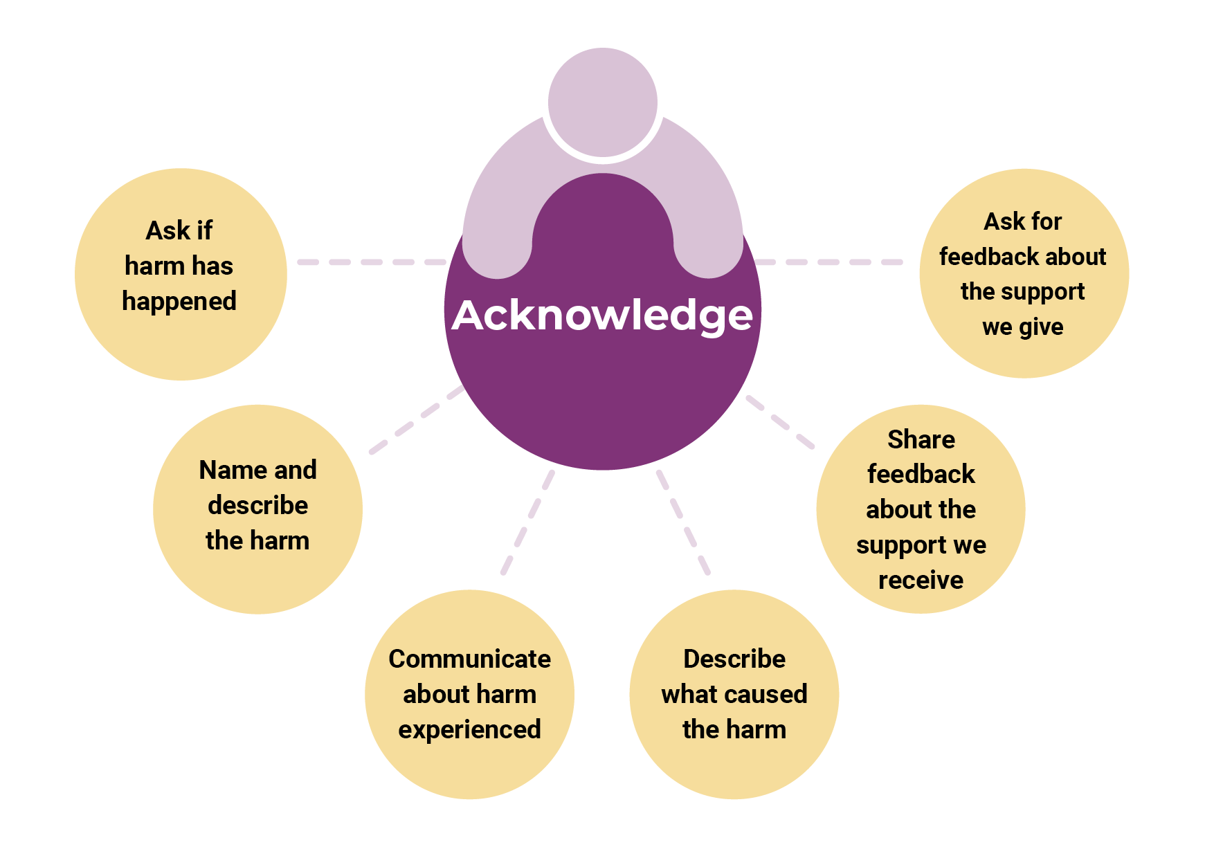
Acknowledge everyday harm

Slide 17
Respond to everyday harm
We can share and solve the problem together to respond to everyday harm.
We can
Ask how we can work better together
Share ideas about the cause of the harm, our own actions, other people’s actions, and the situation where the harm occurred
Plan together about how to resolve the harmful situation
Identify who can help us resolve the harm
Check if we need help from other people to resolve the harm

Slide 18
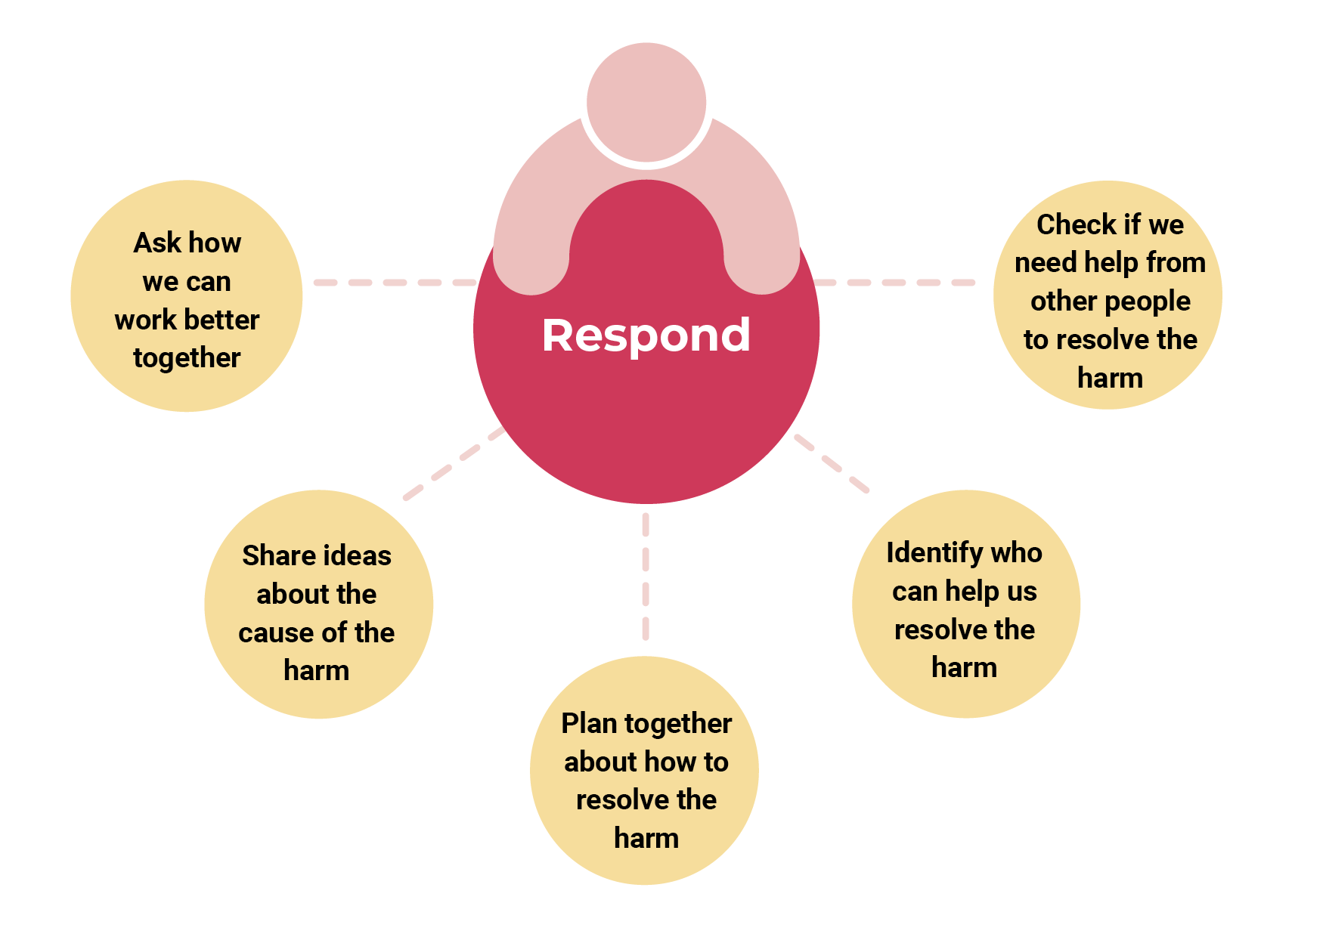
Respond to everyday harm

Slide 19
Repair everyday harm
After we respond to everyday harm, we often need to repair it.
We can repair harm together by
Apologising and by expressing forgiveness
Asking for help from the supporters we trust
Listening and acknowledging.
We work together to find a solution that everybody is happy with.
Notes:
Sometimes we can repair harm together, and sometimes we need help from other people.
If we need help to repair harm, we can ask for help from our supporters we trust. They might be a support service, professional, friends or family. They can have processes to help us repair harm.

Slide 20
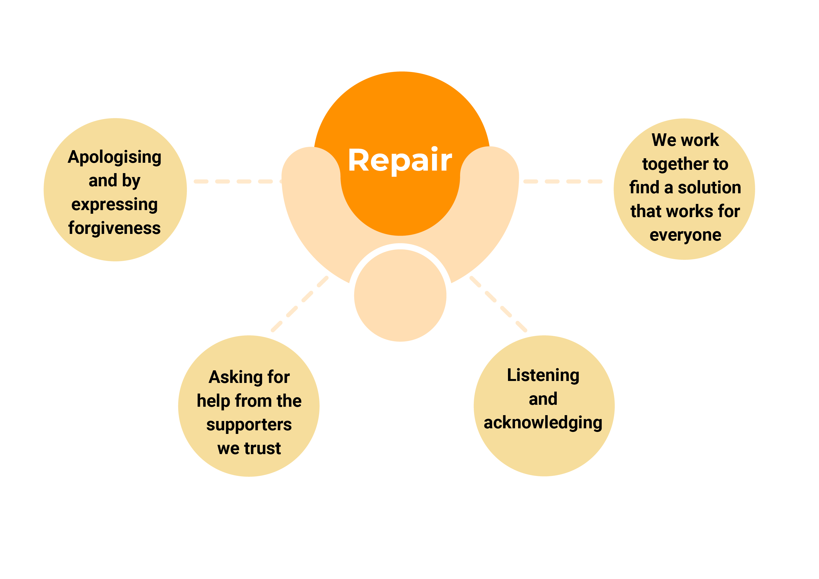
Repair everyday harm
Notes:
Sometimes we can repair harm together, and sometimes we need help from other people.
If we need help to repair harm, we can ask for help from our supporters we trust. They might be a support service, professional, friends or family. They can have processes to help us repair harm.

Slide 21
Make things better
There are many ways we can make things better going forward.
We can
make changes in our relationships to prevent harm from happening again.
Make positive changes in our support services to make a good vibe.
Create safe spaces so that everyday harm stands out.
The more we practice the easier it is to prevent and address everyday harm.
Notes:
Share feedback about the support we receive. Ask for feedback about the support we give

Slide 22
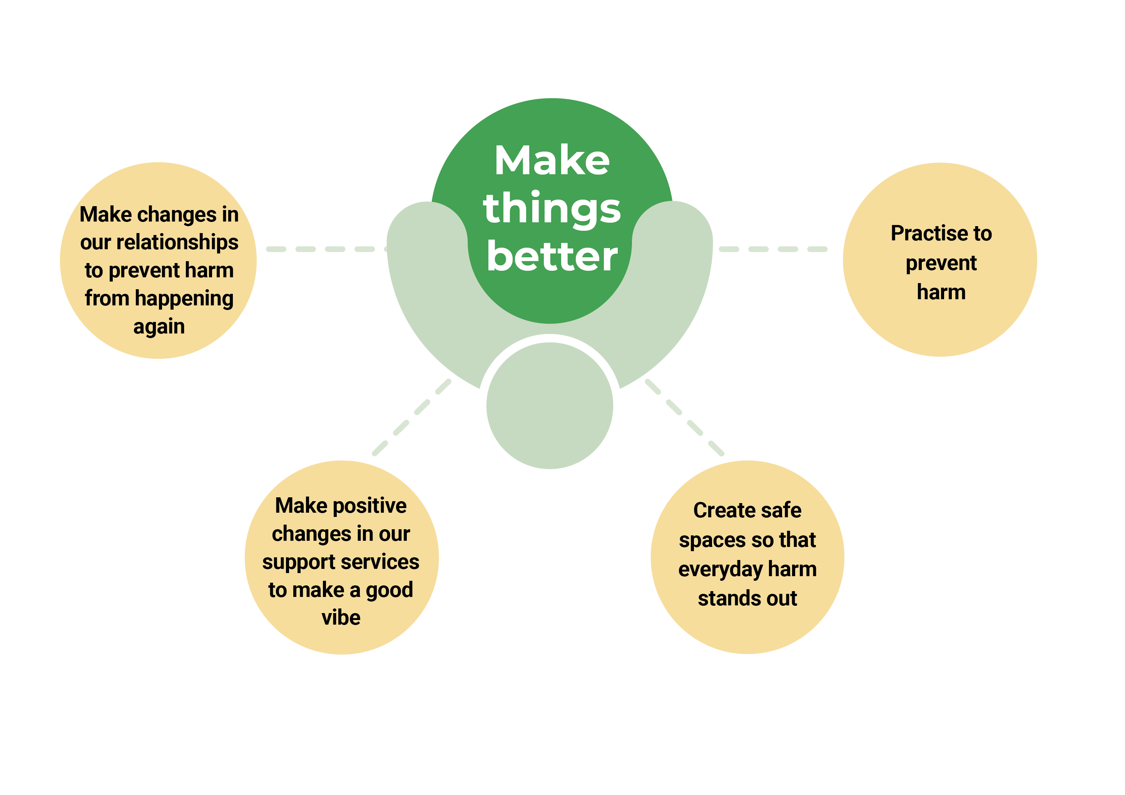
Make things better
Notes:
Share feedback about the support we receive. Ask for feedback about the support we give

Slide 23
ADDRESSING EVERYDAY HARM
Make things better
Notice
Acknowledge
Respond
Repair
Make things better
Name everyday harm
Ask if harm
Ask how we can work
Apologising and by
Make changes in
has happened
better together
expressing forgiveness
our relationships to prevent harm from happening again
Describe everyday harm
Name and describe the harm
Share ideas about the cause of the harm
Plan together about how to resolve the harm
Asking for help from the supporters we trust
Make positive changes in our support services to make a good vibe
Build trust
Communicate about harm experienced
Listening and acknowledging
Understand how we communicate
Describe what caused the harm
Share feedback about the support we receive
Identify who can help us resolve the harm
We work together to find a solution that works for everyone
Create safe spaces so that everyday harm stands out
Learn about past harm
Check if we need help from other people to resolve the harm
Practise to prevent harm
Ask for feedback about the support we give

Slide 24
Applying the everyday steps
Work in pairs to respond to these questions:
What stands out about the everyday steps for you?
How could the everyday steps apply to your work?
What everyday steps can you take to address and repair everyday harm in your work?
Notes:
Share feedback about the support we receive. Ask for feedback about the support we give

Slide 25
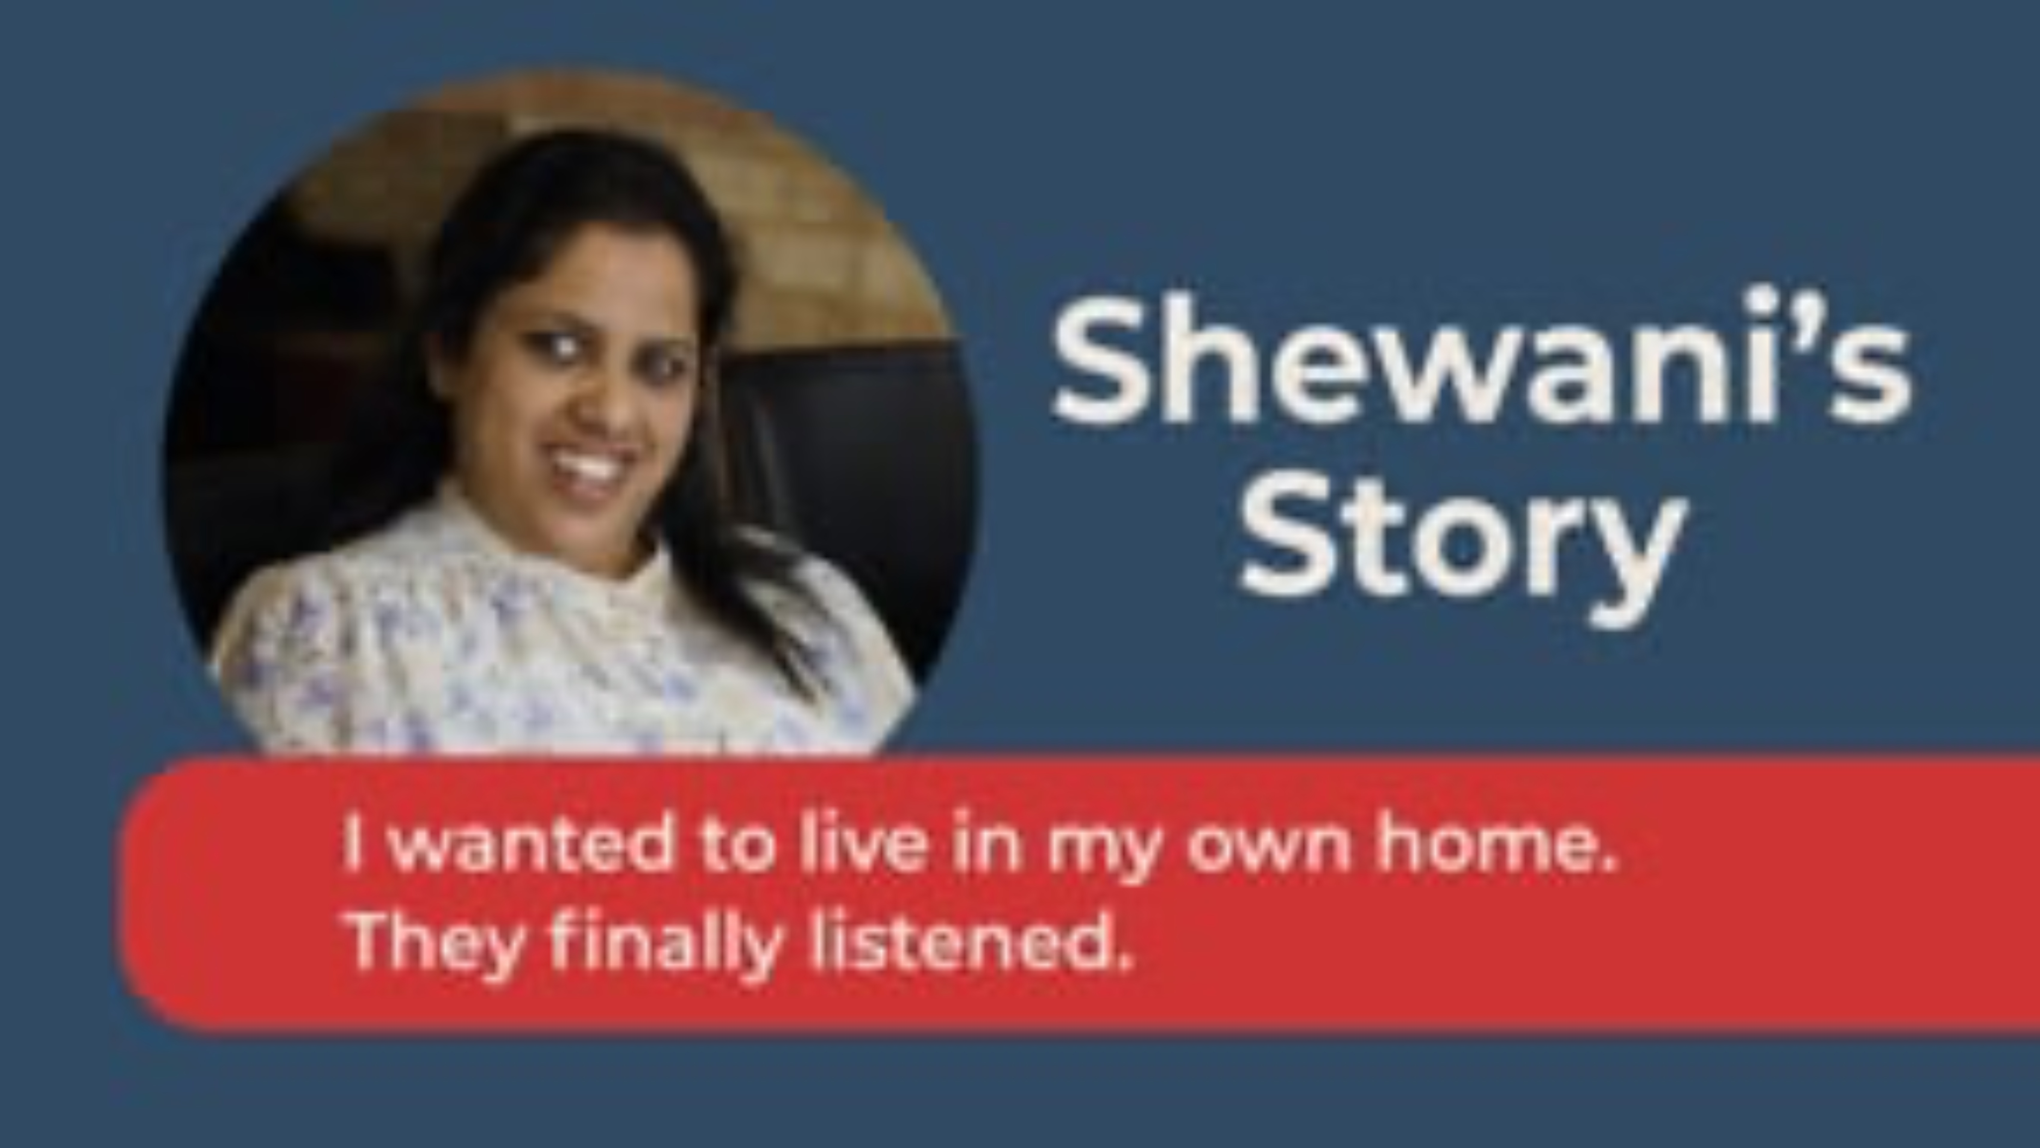
Shewani’s Story

Slide 26
Reflect on Shewani’s Story
How did the people around Shewani notice things were not ok? (Notice)
What did the people around Shewani do once the noticed everyday harm was happening? (Acknowledge)
How did Shewani’s support workers respond when she shared about her experience of everyday harm? (Respond)
How did Shewani and her support workers take action together? (Repair)
How could Shewani and her support workers stop everyday harm happening in the future? (make things better)
What were the positive impacts of Shewani and her support workers addressing everyday harm? (make things better)

Slide 27
ADDRESSING EVERYDAY HARM
Make things better
Notice
Acknowledge
Respond
Repair
Make things better
Name everyday harm
Ask if harm
Ask how we can work
Apologising and by
Make changes in
has happened
better together
expressing forgiveness
our relationships to prevent harm from happening again
Describe everyday harm
Name and describe the harm
Share ideas about the cause of the harm
Plan together about how to resolve the harm
Asking for help from the supporters we trust
Make positive changes in our support services to make a good vibe
Build trust
Communicate about harm experienced
Listening and acknowledging
Understand how we communicate
Describe what caused the harm
Share feedback about the support we receive
Identify who can help us resolve the harm
We work together to find a solution that works for everyone
Create safe spaces so that everyday harm stands out
Learn about past harm
Check if we need help from other people to resolve the harm
Practise to prevent harm
Ask for feedback about the support we give

Slide 28
Noticing everyday harm
Noticing is an important first step in addressing everyday harm when it happens.
Work in pairs to respond to these questions:
In the past, have you noticed everyday harm happening?
How did you respond when you noticed it?
What might you do differently now?

Slide 29
Preventing and addressing everyday harm

Slide 30
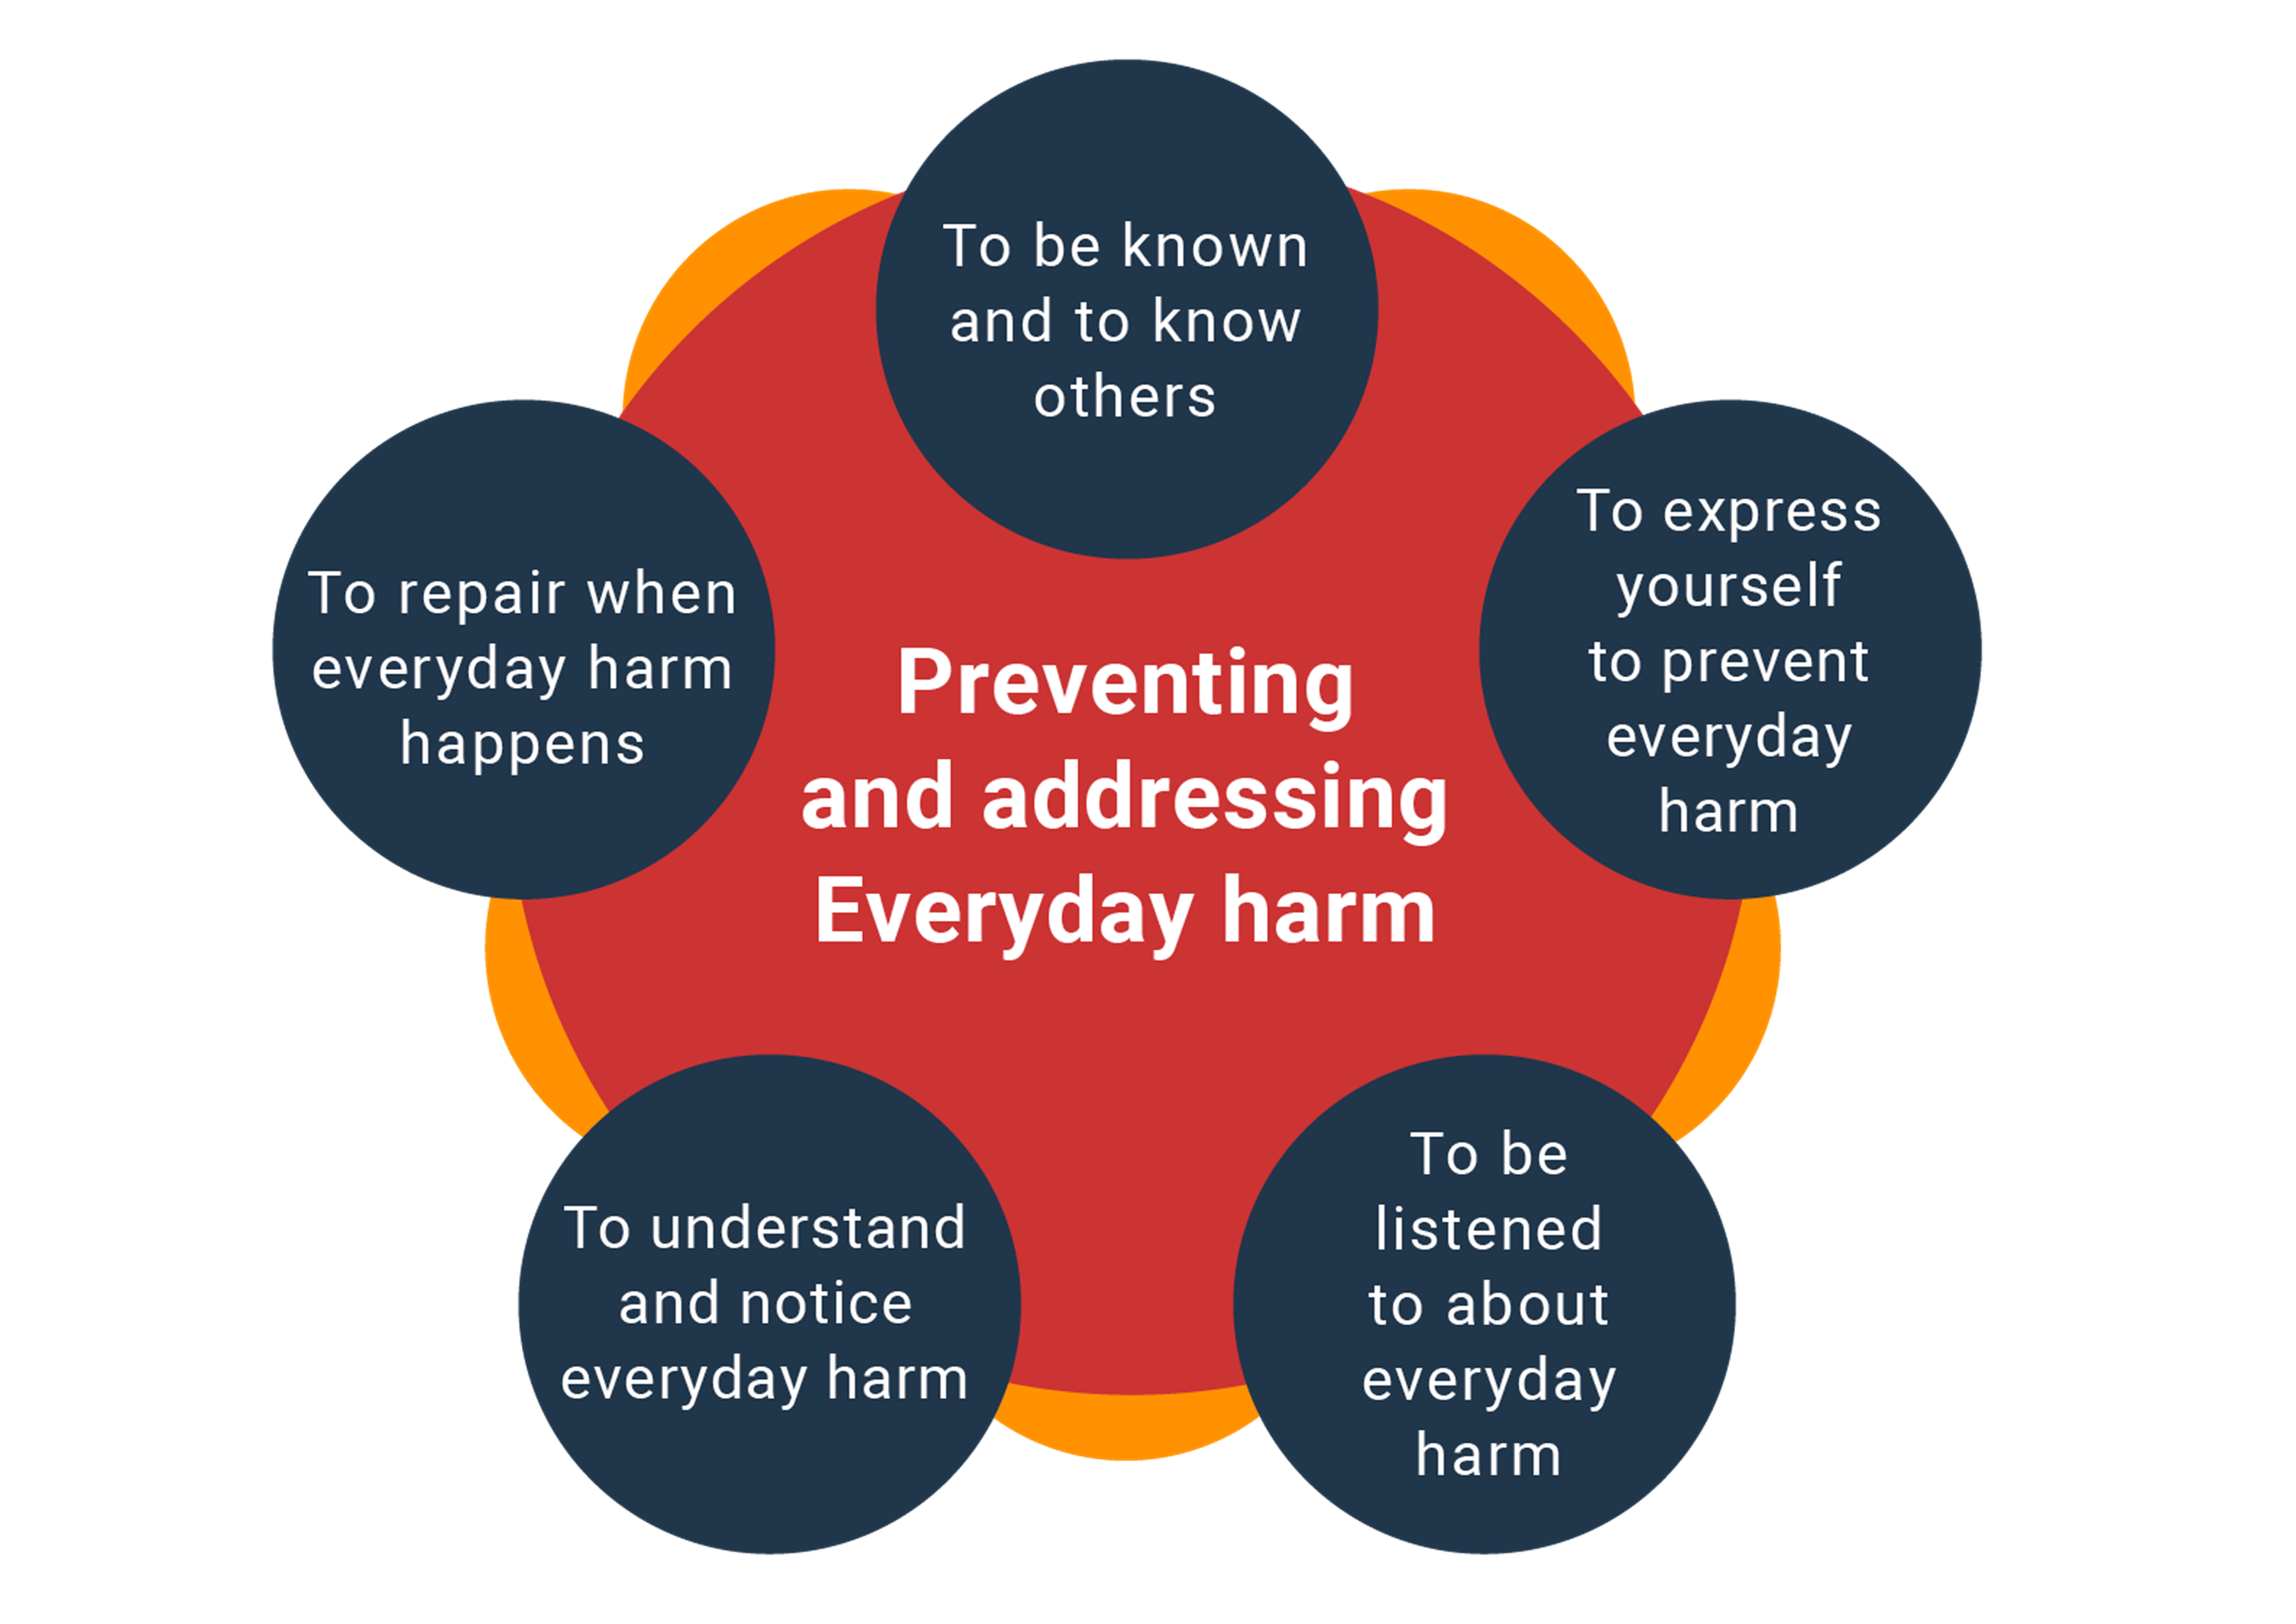
Five rights in preventing and addressing everyday harm

Slide 31
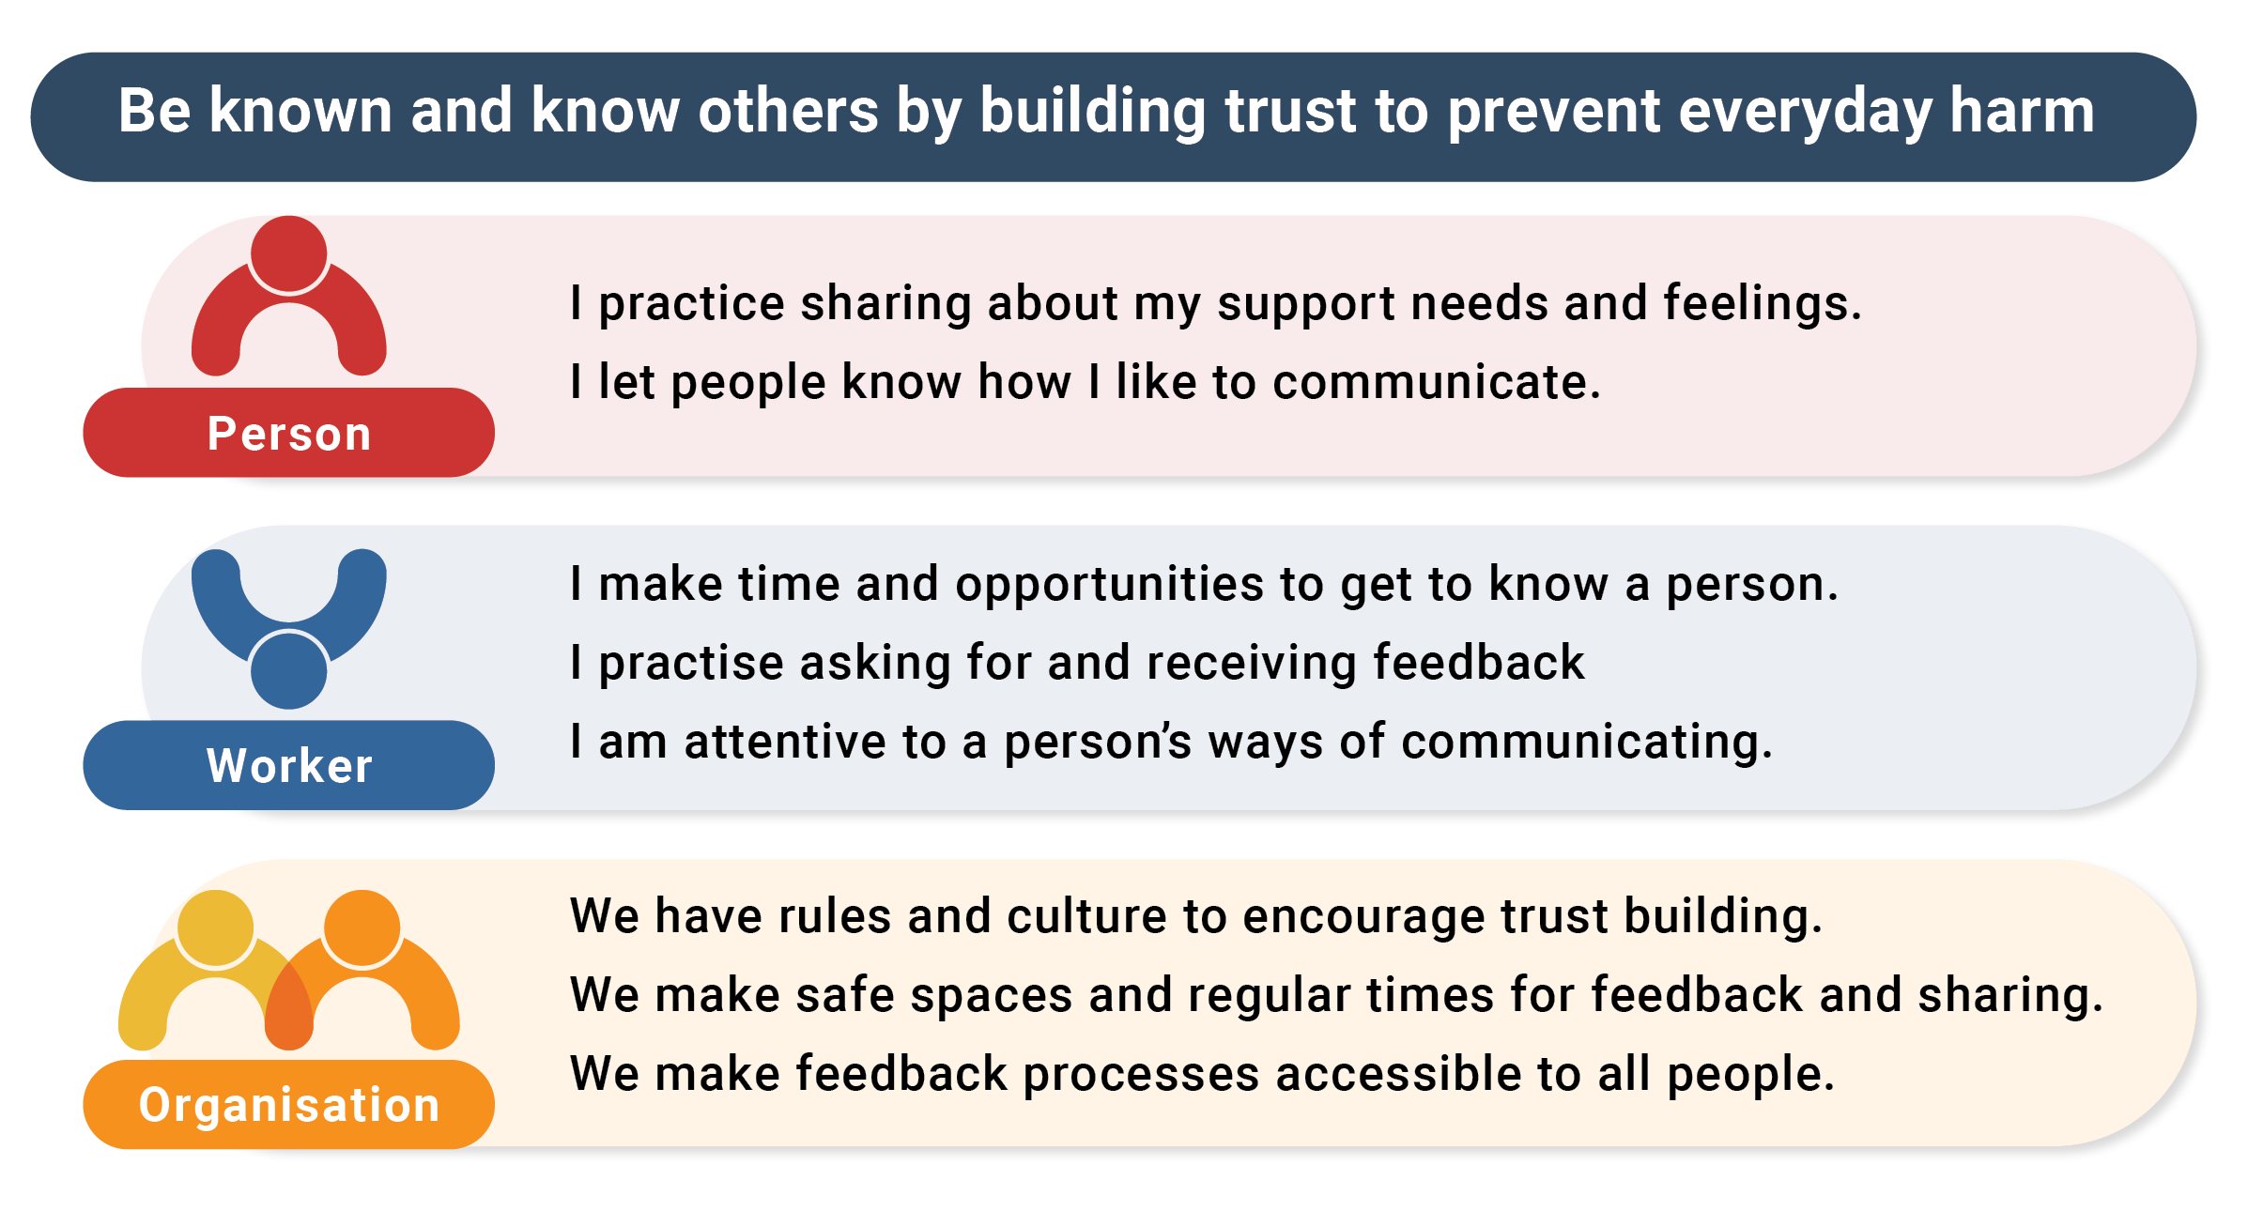

Slide 32
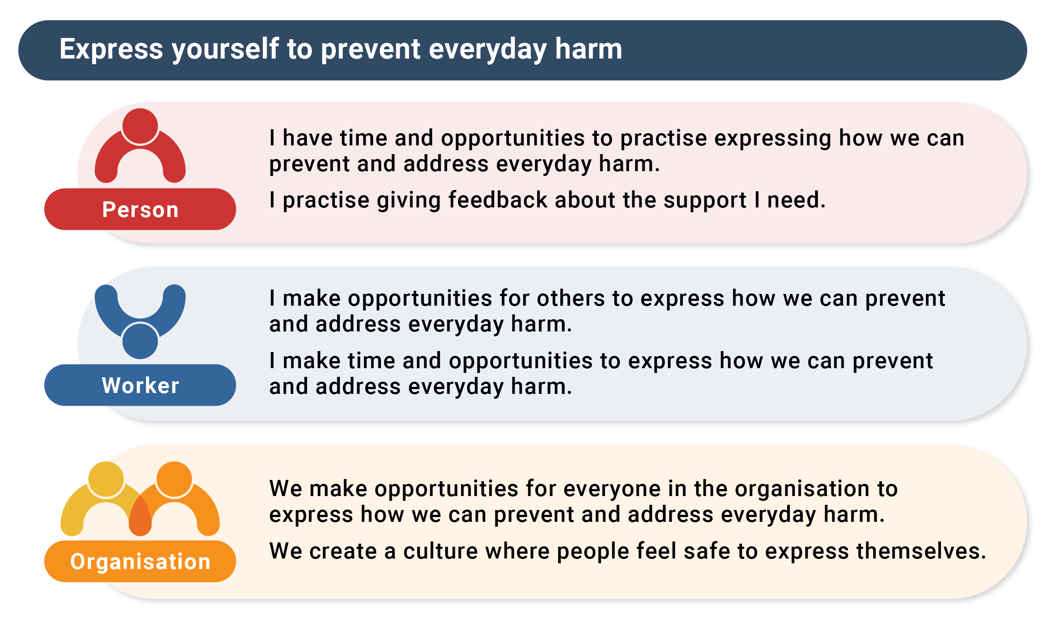

Slide 33
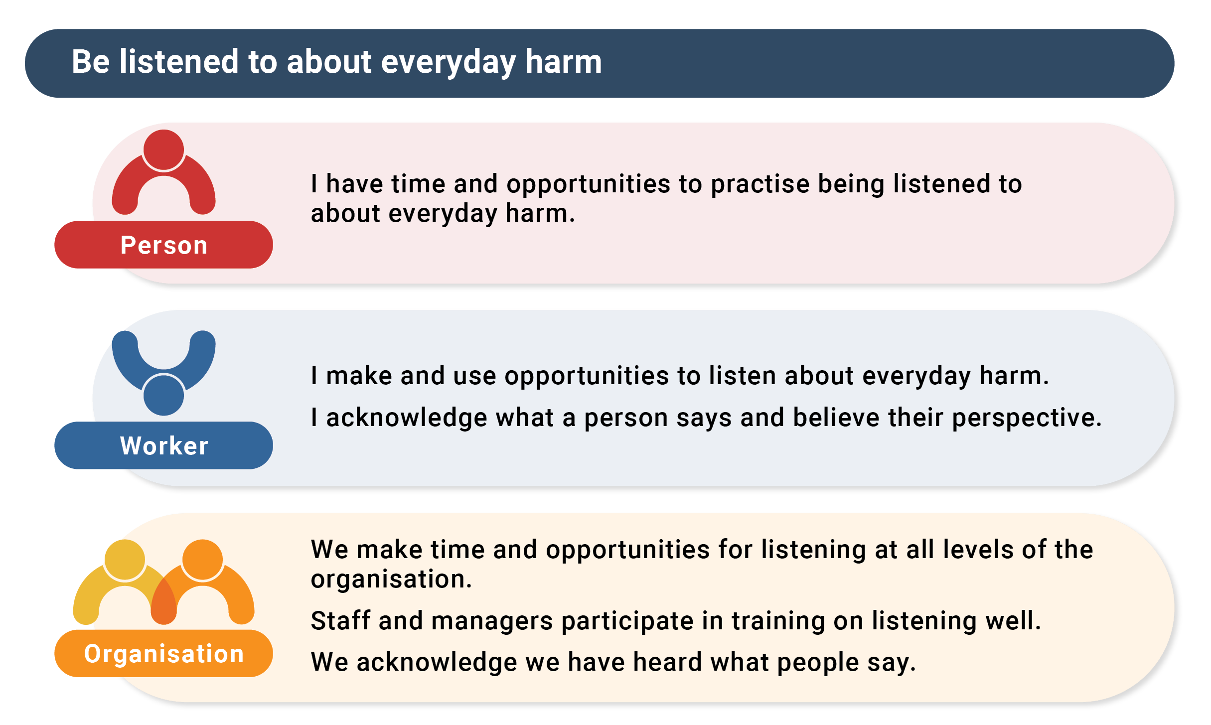

Slide 34
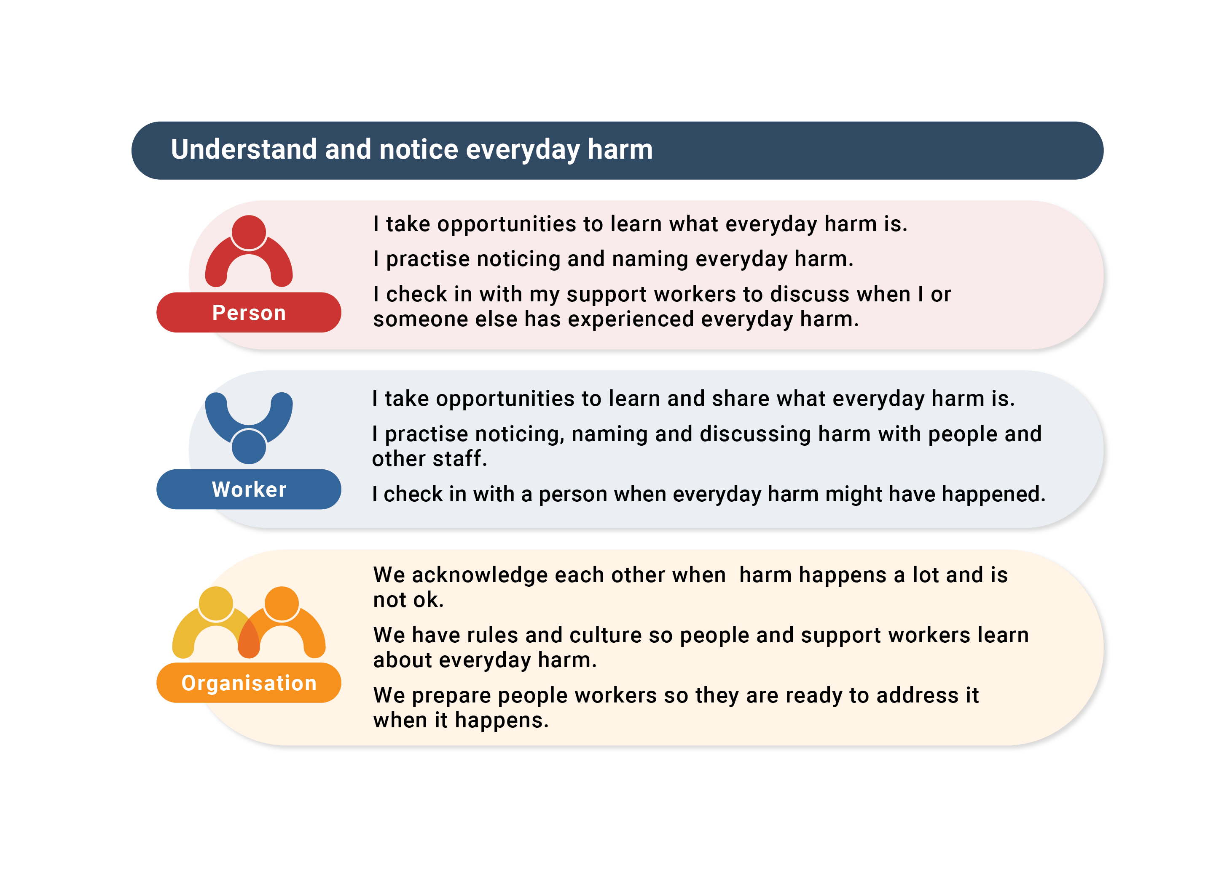

Slide 35
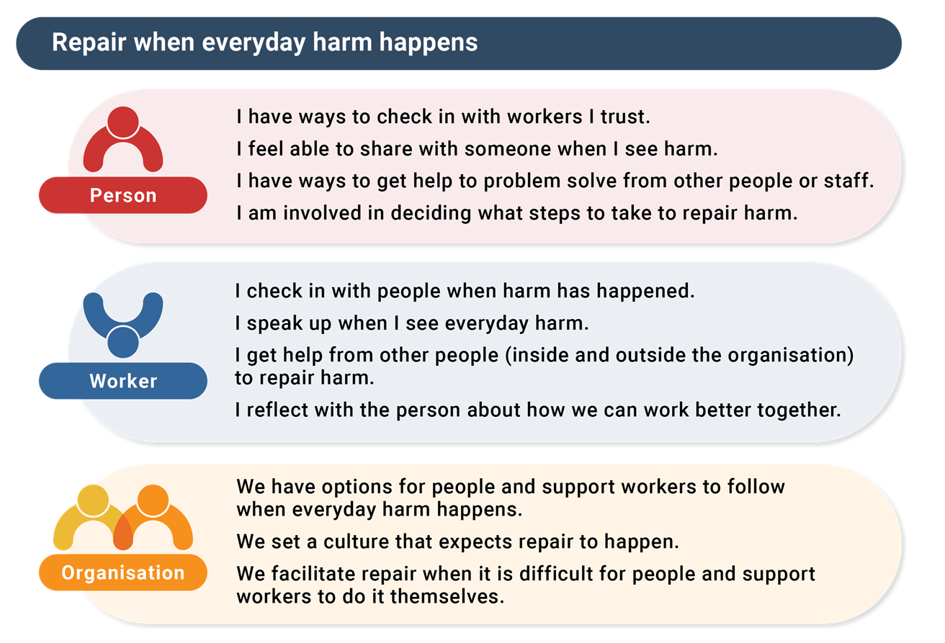
Waiting on new graphic

Slide 36
What do these five rights make you consider for the way you work together?

Slide 37
Improving our systems

Slide 39
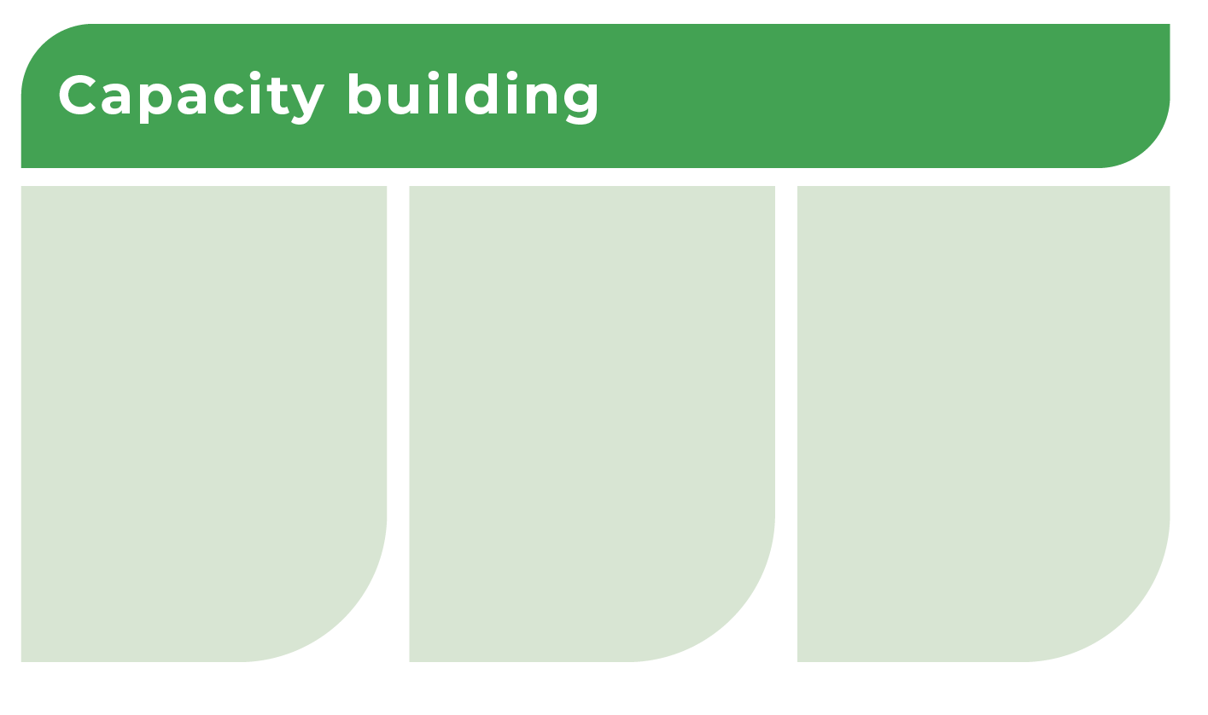
Facilitate people to be trainers with workers, peers and families.
Organise places, time and training for staff and people together to:​
talk about good practices for changing everyday harm
reflect on ways to improve support ​
practise how to check in and listen to each other without judgement
Build in supervision and communication loops between the person, worker, leader, manager and board.
Use the loops to find, fix and share everyday harm problems at the personal and organisational levels.

Slide 40

Choose support workers and managers who understand everyday harm.
Set clear work expectations that prevent and address everyday harm in organisational culture and individual support.
Make time to regularly review the match between the person and worker to find and fix everyday harm problems or replace the support relationship.

Slide 41
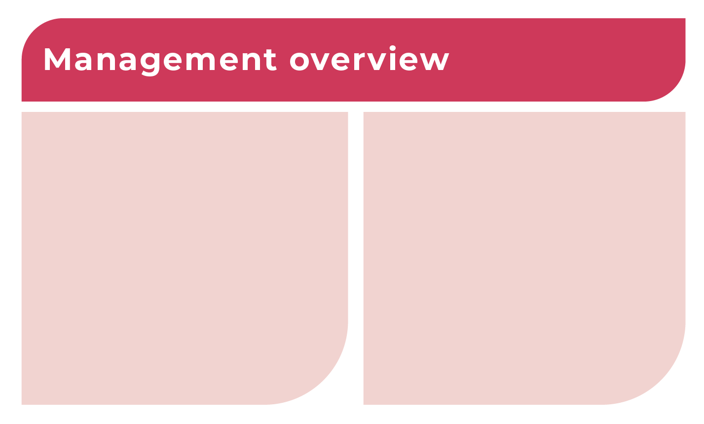
Track everyday harm to understand how to prevent and address it and improve the quality of support:
Ask people, staff, families and visitors about everyday harm they notice to self or others
Ask people and staff about how to change everyday harm where they work.
Make ways to tell people how their ideas about change to everyday harm have been acted on.

Slide 42
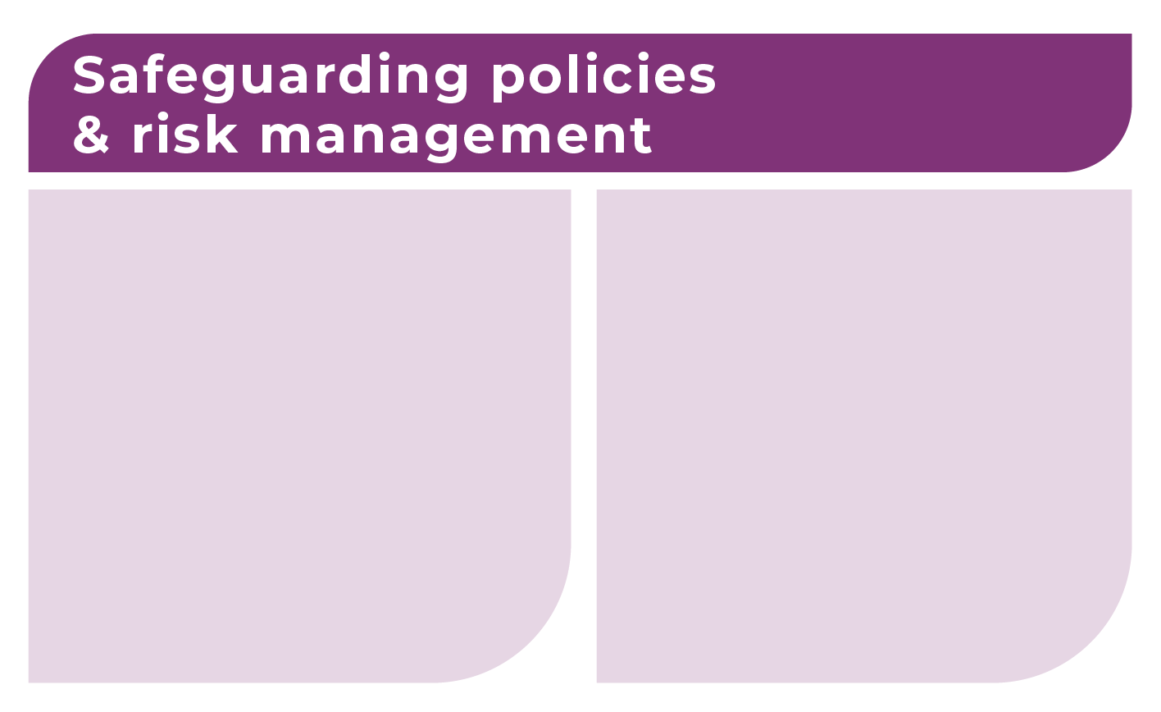
Build a culture that encourages people, families, staff and managers to speak up when they notice everyday harm​:
Make time and places to practise speaking up​
Celebrate organisational culture and support relationships that find and fix everyday harm.
Have rules that encourage and manage responses when people, workers and families speak up about everyday harm.

Slide 43
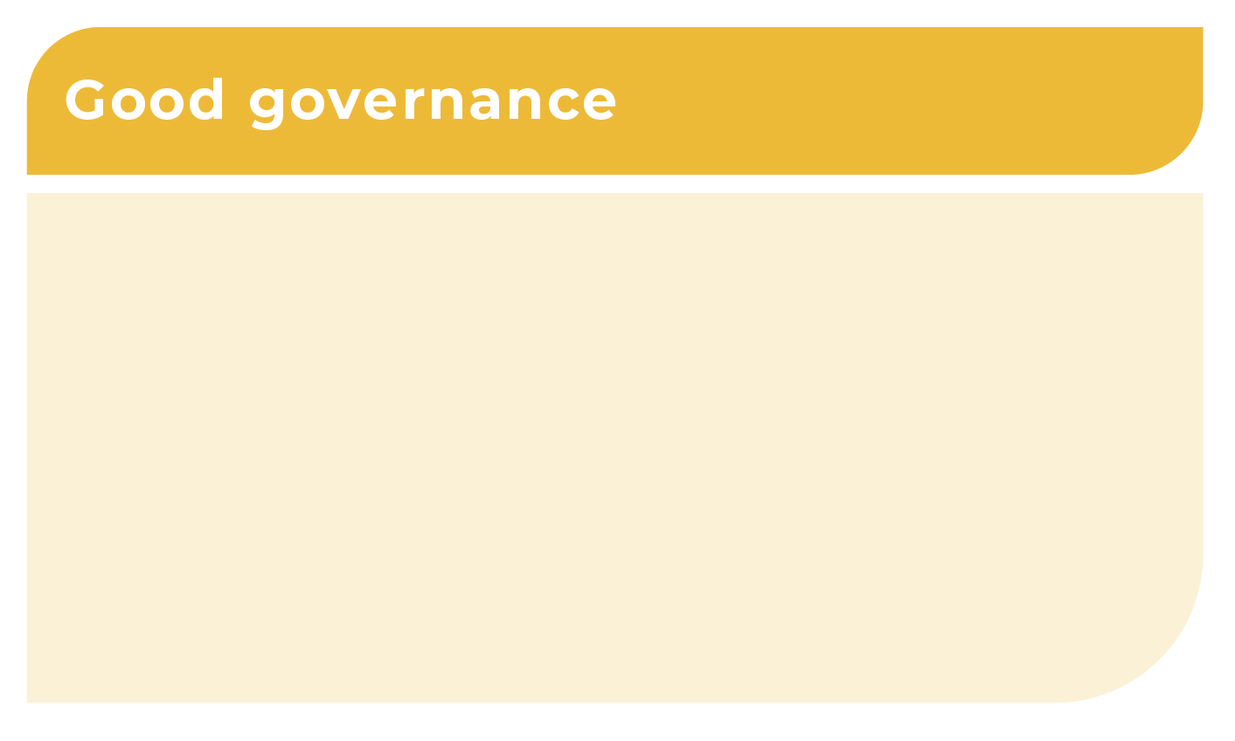
Include people with disability in making decisions about how to organise changes to prevent and address everyday harm:
  Include people with disability in quality improvement processes
  Have ways to share information directly from people with disability to managers and board
  Report back to people with disability about decisions and actions by managers and boards to prevent and address everyday harm.

Slide 44
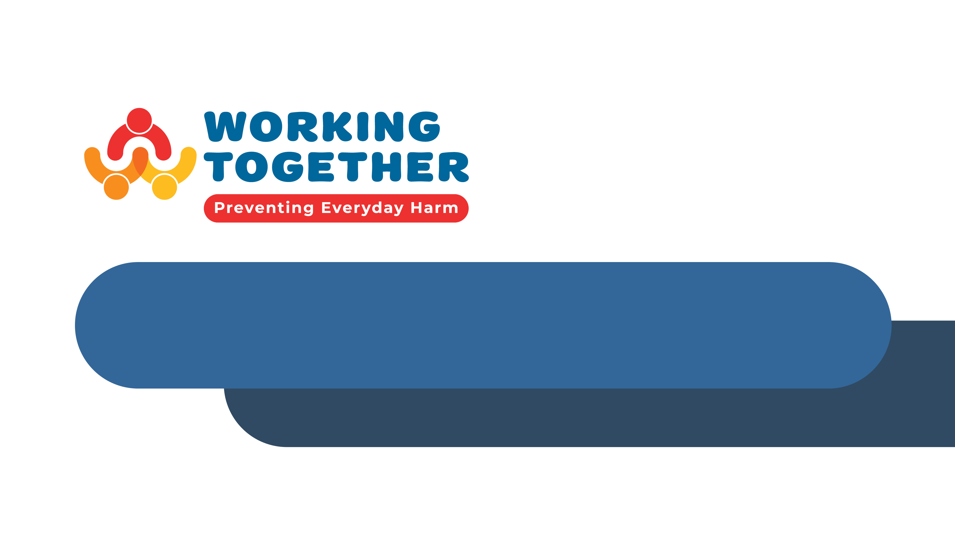
Slide title
Wrap up and reflection

Slide 45
Reflection
Based on your learning about preventing everyday harm what will you do differently...
In your work together?
In your organisation?

Slide 46
Acknowledgement
This training was developed using research developed from the Australian Research Council project Working together to prevent everyday harm of young people with cognitive disability (LP210200536).
Our team includes academics, people with disability and partner community organisations. Everyone in our team has expert knowledge from their own experience.
Thank you to all the people with disability, support workers and managers who contributed to the research.
For more information about the project or team, please contact the project lead, Professor Sally Robinson, sally.robinson@flinders.edu.au

